Slide 1
customer review data analysis
for British Airways

Slide 2
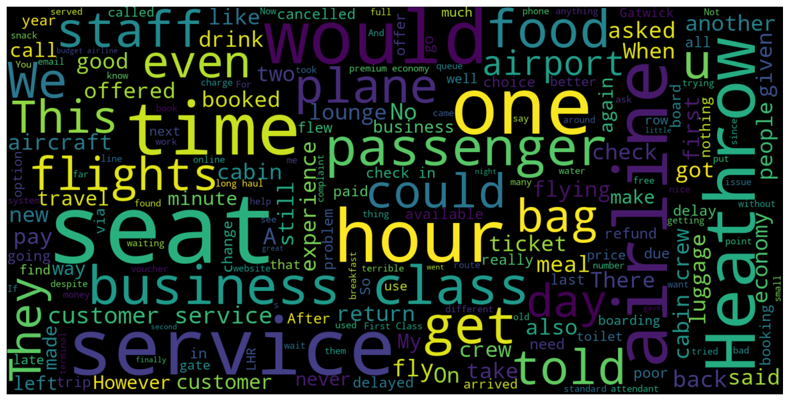
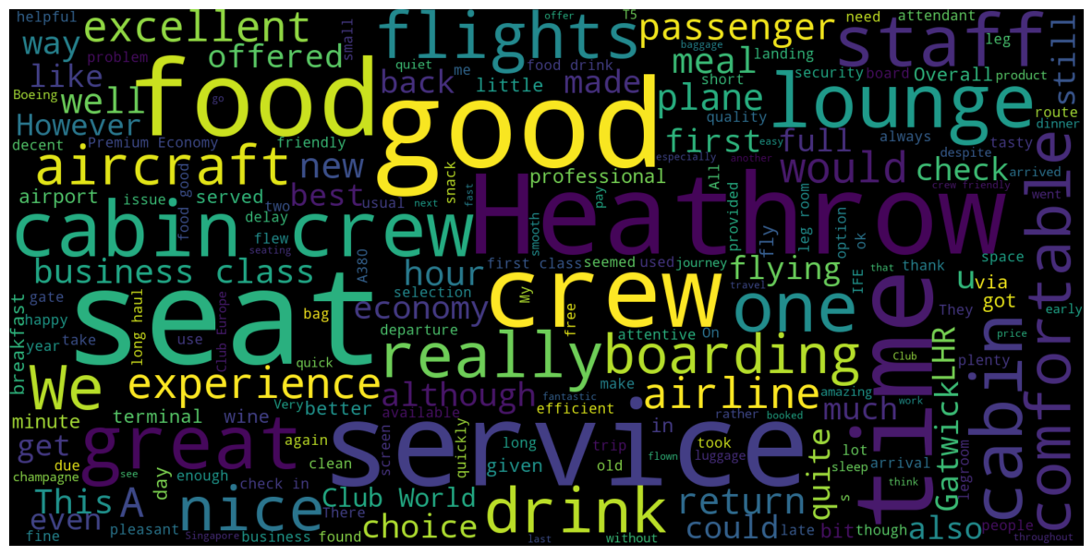
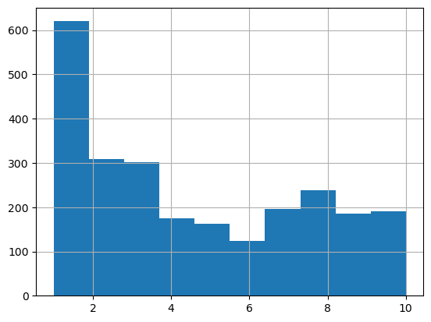
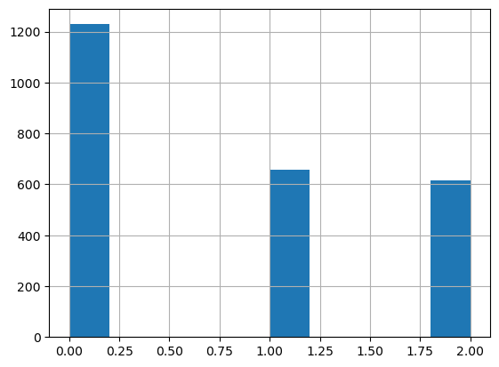
The main idea of this analysis was to use Skytrax website reviews to better understand needs of British Airways’ customers.
Using sentiment analysis the reviews were divided into 3 groups - negative, neutral and positive. Negative reviews were with the rate 1-3 (out of 10), neutral with rate 4-7 and positive reviews with rate 8-10.
To better understand the insight of the reviews only negative and positive groups were taken into consideration, wordclouds were used to present findings.
For negative reviews, we should make further analysis for topics: “business class”, “plane”, “bag” and generally “time” (word “hour” highlighted in wordcloud.
For positive reviews, we should make further analysis of strong sides of BA like: “cabin crew”, “lounge”, “food”
Negative reviews findings
Distribution of ratings
Distribution of ratings after sentiment analysis
Positive reviews findings

